Slide 1
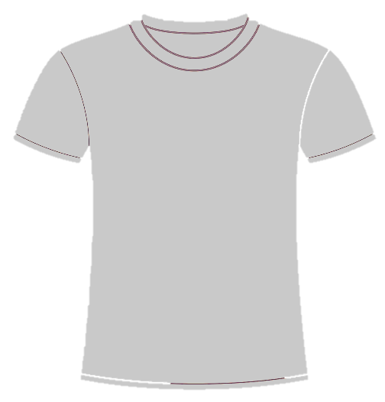
Posture-Detecting Shirt
Angela Chen, May – July 2018

Slide 2
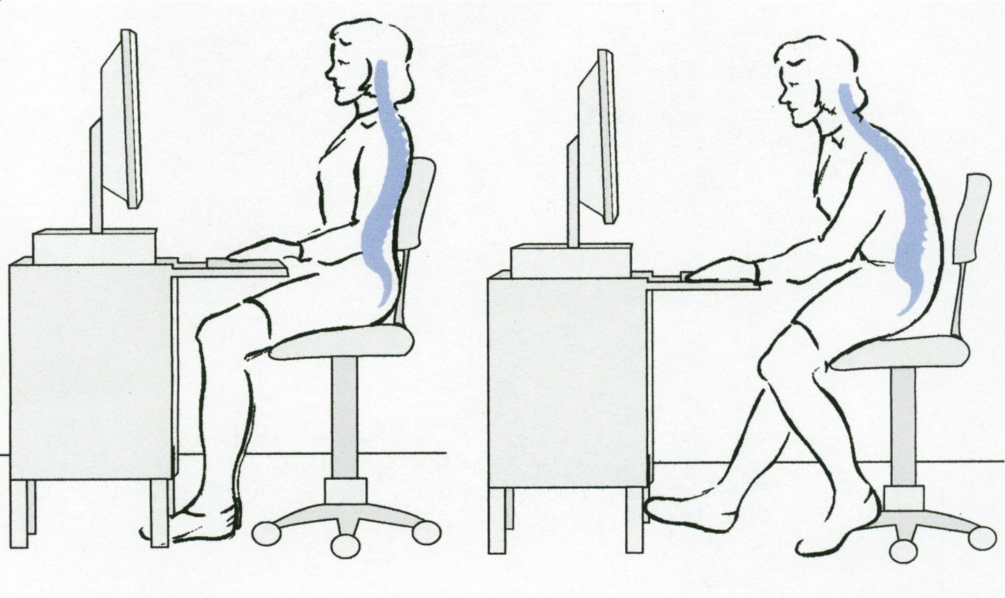
Background
Poor posture is unhealthy
It’s a habit that may be difficult to correct
A system to detect and remind a user of their posture:
Portable
Not restrictive
Accurate
Decided to use “e-textiles”; the challenge is accuracy.
Electronic textiles

Slide 3
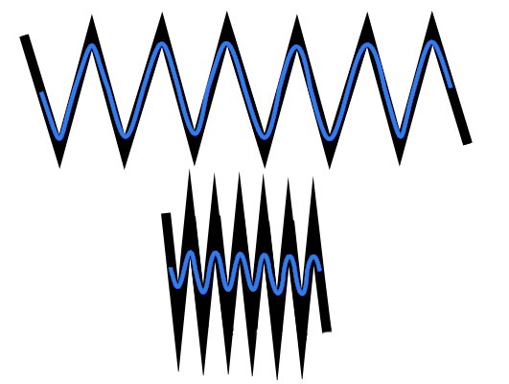
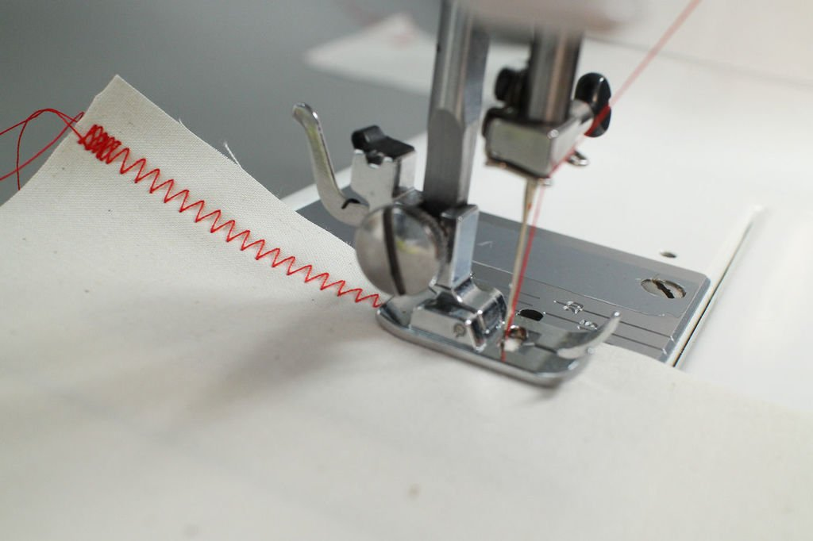
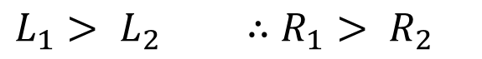
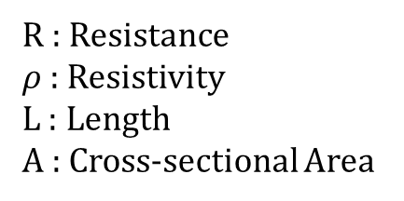
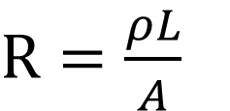
Stitched Sensor
1
Thread
Path of current
2
Variable resistor that has higher resistance when stretched.
Made with conductive thread sewn in a zig-zag pattern.
R : Resistance
$ρ$: Resistivity
L : Length
A : Cross-sectional Area
$R=\frac{ρL}{A}$
$L_{1}> L_{2} ∴$ $R_{1}> R_{2}$

Slide 4
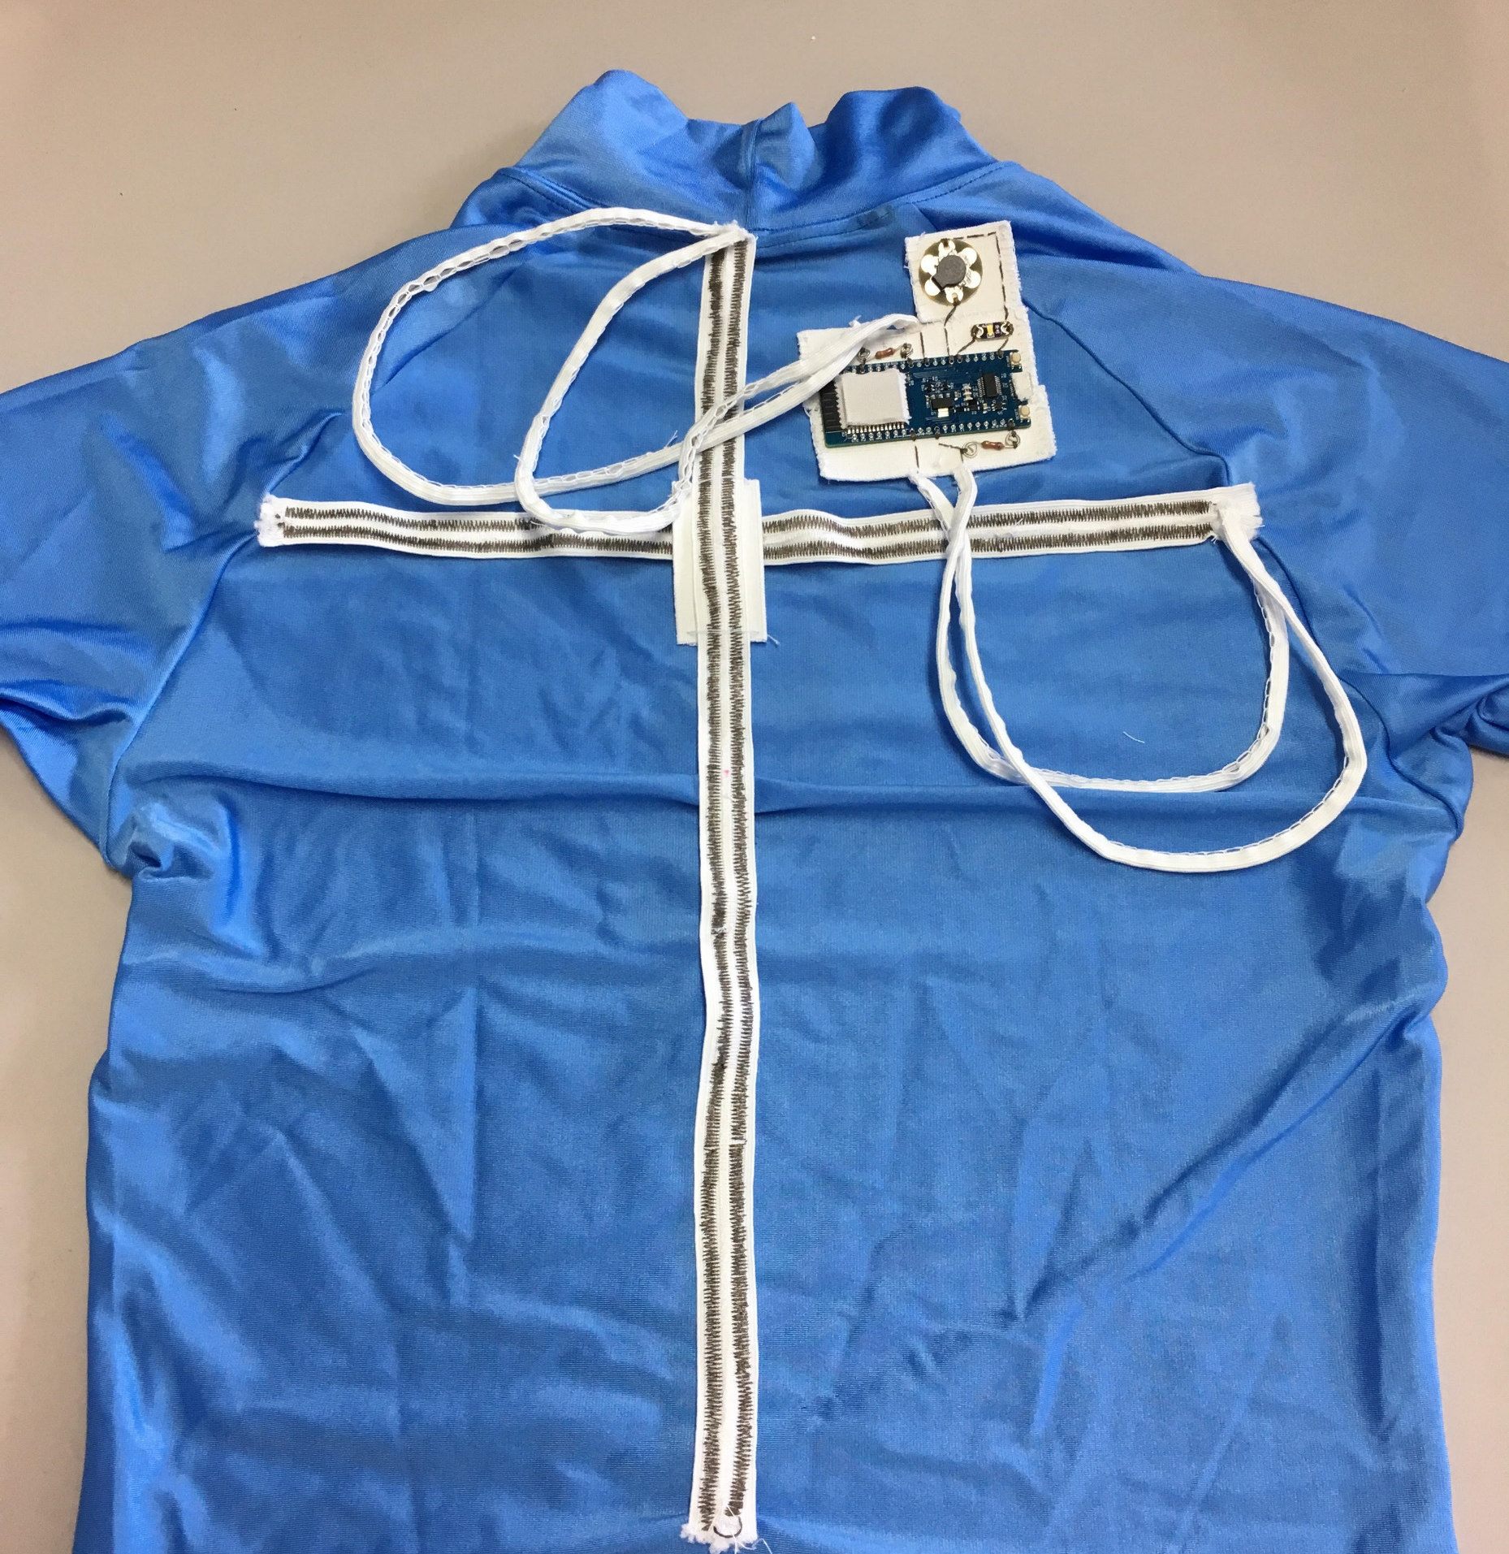
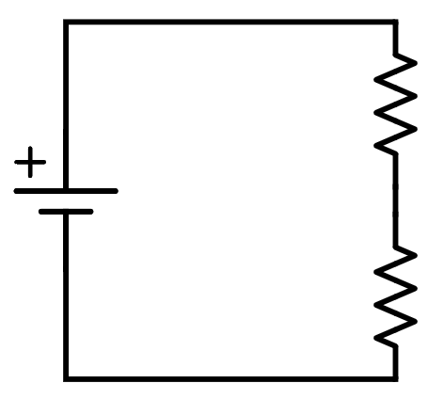
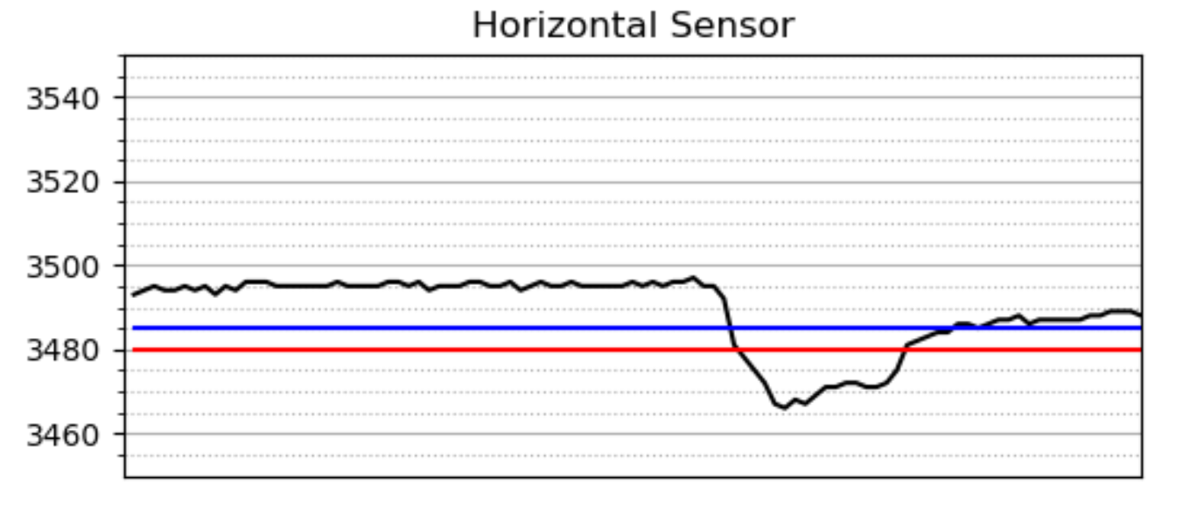
First Design
View of the back of the shirt →
Chose fixed resistor around the same resistance as average value of stitched resistor for better sensitivity.
Analog Input
Good posture
Good
posture
Poor posture

Slide 5
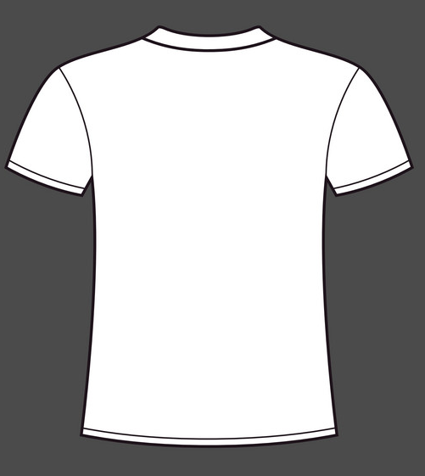
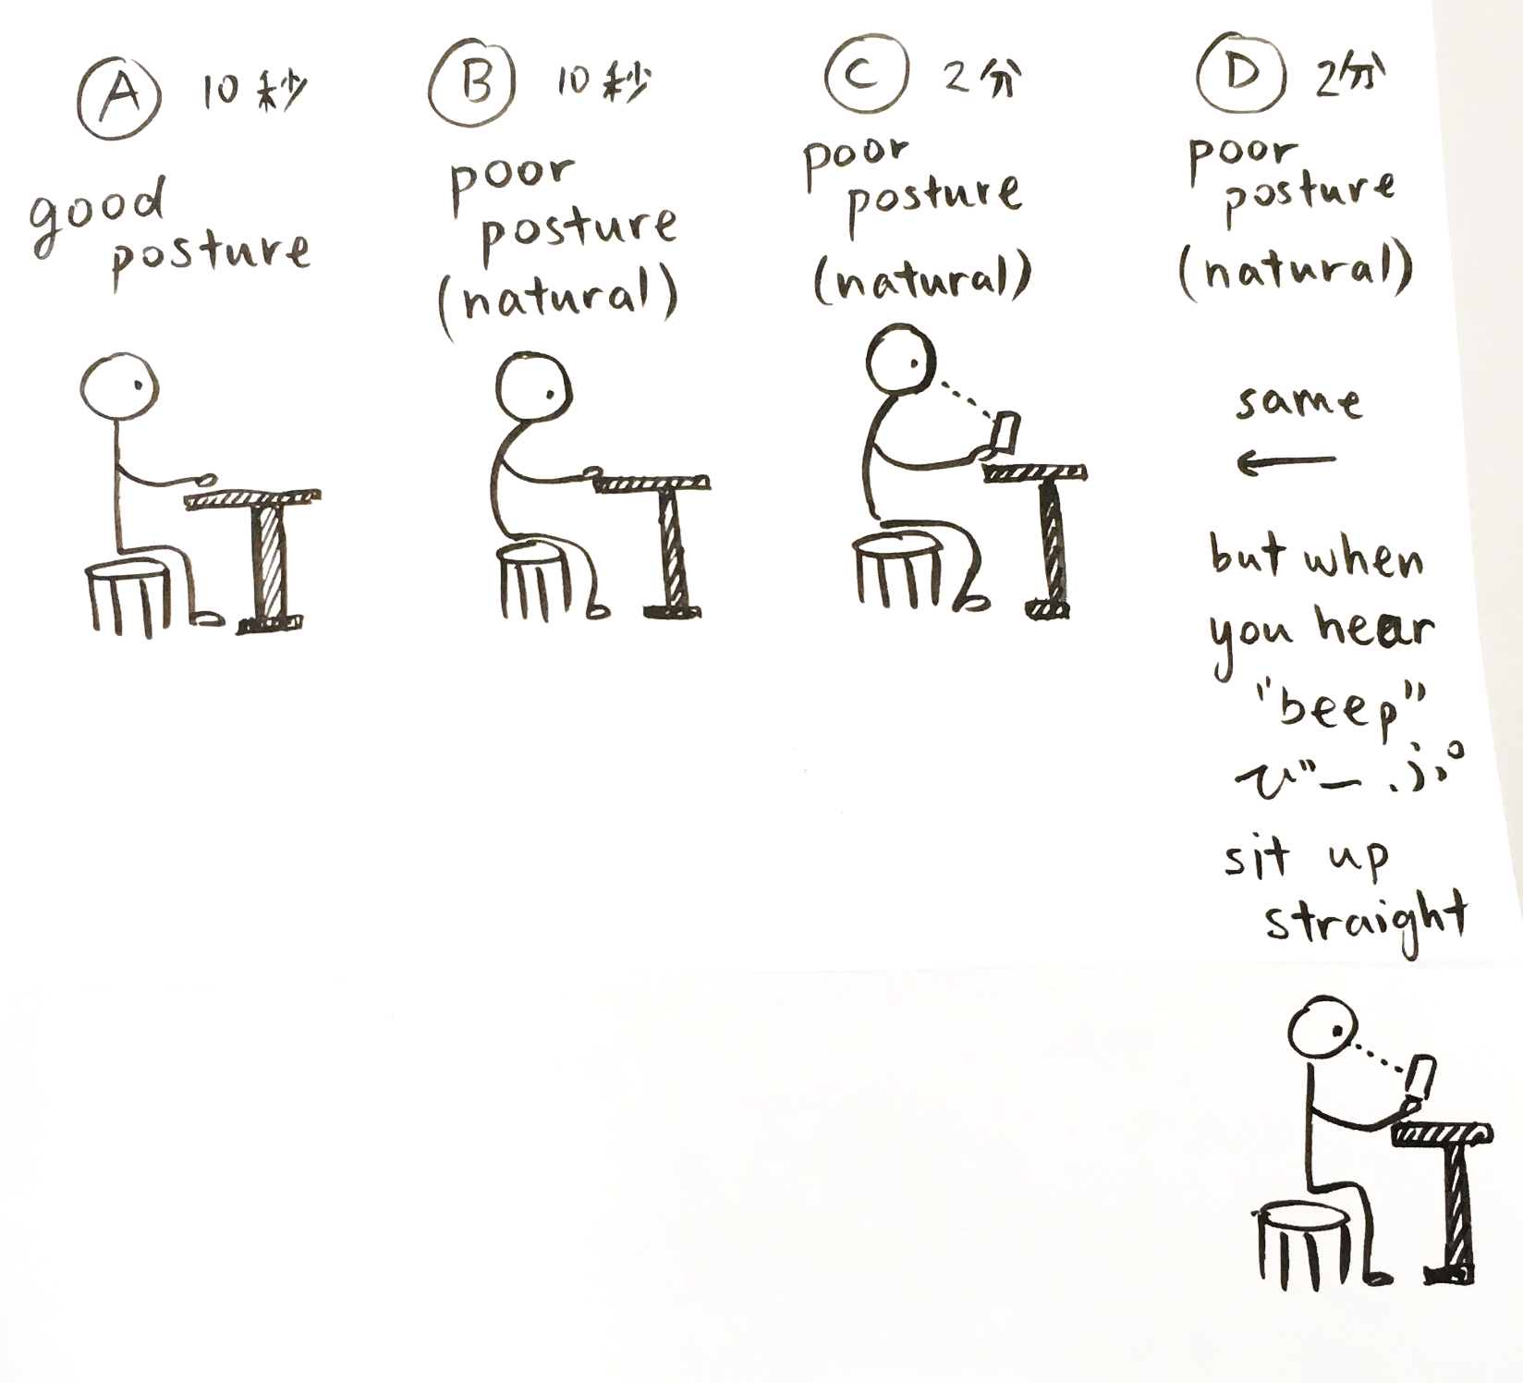
3D Motion Capture
L
T
R
C
5 markers, creating two lines
Found that the change in ∠TCB is best for determining posture
Using motion capture results to determine if posture can be correctly detected by the shirt
Case 1: A vs B - Comparing “good” vs “poor”
Case 2: C vs D - Comparing “natural” vs “with buzzer”
B

Slide 6
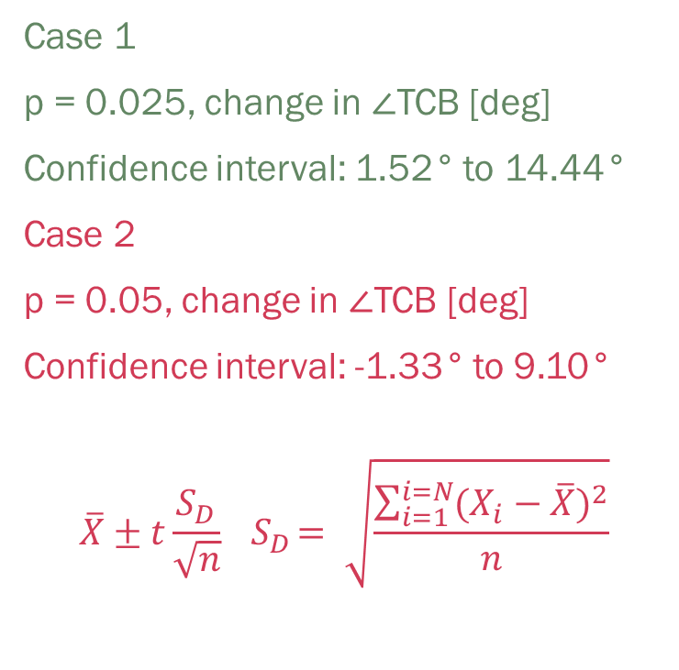
Results and Feedback (1st Design)
Paired T-test
Case 1: The motion capture can identify a difference between good and poor posture
Case 2: Motion capture results show that the shirt does not significantly help
Mixed feedback from participants about the sensitivity
Case 1
p = 0.025, change in ∠TCB [deg]
Confidence interval: 1.52° to 14.44°
Case 2
p = 0.05, change in ∠TCB [deg]
Confidence interval: -1.33° to 9.10°
$$\overline{X}±t\frac{S_{D}}{\sqrt{n}}{ S}_{D}= \sqrt{\frac{\sum_{i=1}^{i=N}{{(X_{i}−\overline{X})}^{2}}}{n}}$$

Slide 7
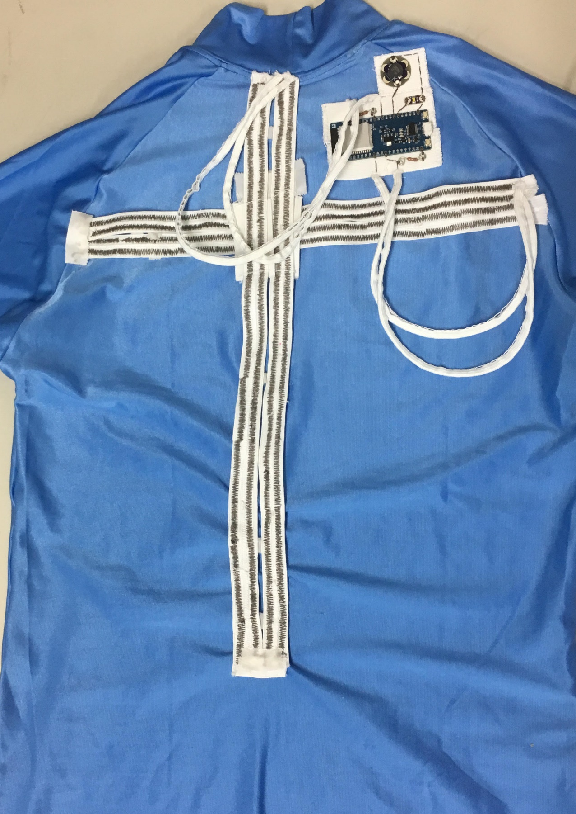
Second Design
1. Increase accuracy of sensors →
Re-sewed loose vertical sensor
2x length of both resistors
2. Better method of finding threshold →
Set manually for each person
3. Account for slow recovery time →
Cooldown time for buzzer

Slide 8
Results and Feedback (2nd Design)
The shirt could still not significantly change participants’ postures
Less false positives now
Feedback from participants:
Arm movement will affect the sensor
Still not very accurate
Cannot detect leaning
Case 1
p = 0.025, change in ∠TCB [deg]
Confidence interval: 2.62° to 21.12°
Case 2
p = 0.05, change in ∠TCB [deg]
Confidence interval: -6.42° to 16.40°

Slide 9
Challenges
Human bodies vary greatly as well as each person’s good/poor posture
Shirt was less accurate when sensors were not in tension
Some people’s poor posture does not involve curving their back
Improvement ideas
Different construction and position of sensors
Using a SVM to classify posture instead of thresholds
Applying this technology for another purpose, such as detecting breathing or larger movement

Slide 10
Demo

Slide 11
Picture Credits
https://www.vectorstock.com/royalty-free-vector/blank-t-shirt-template-front-and-back-vector-1544589
https://fromept.com/blog/sitting-posture-rolfing
https://www.instructables.com/lesson/Hemming-and-Seam-Finishing/

